Slide 1
Port of Bremerton Newsletter Update Victoria Peters, Marketing & Communications Cordinator

Slide 2
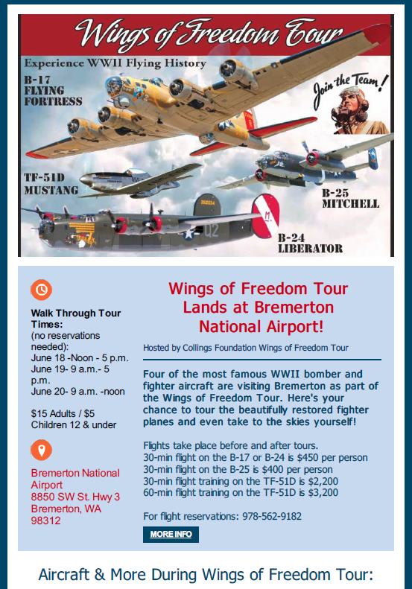
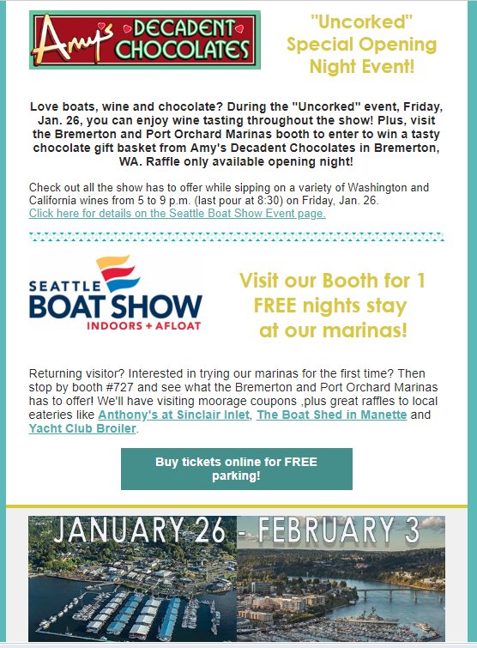
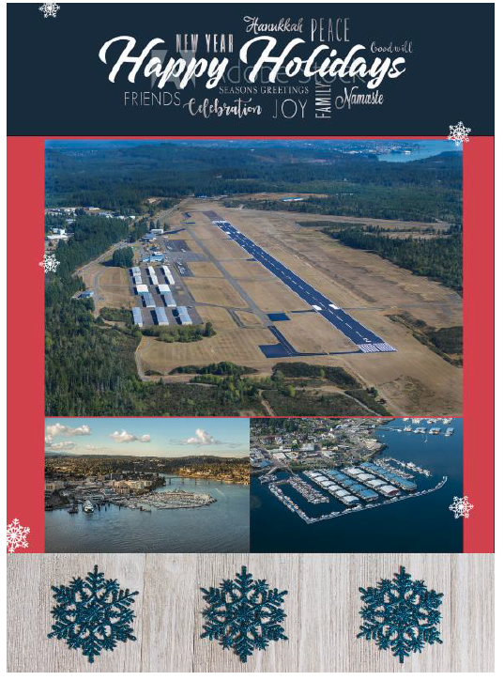
Previous E-blasts
Event Announcements
Attendance at Boat Shows/Trade Shows
Holiday Cards/ Invitations

Slide 3
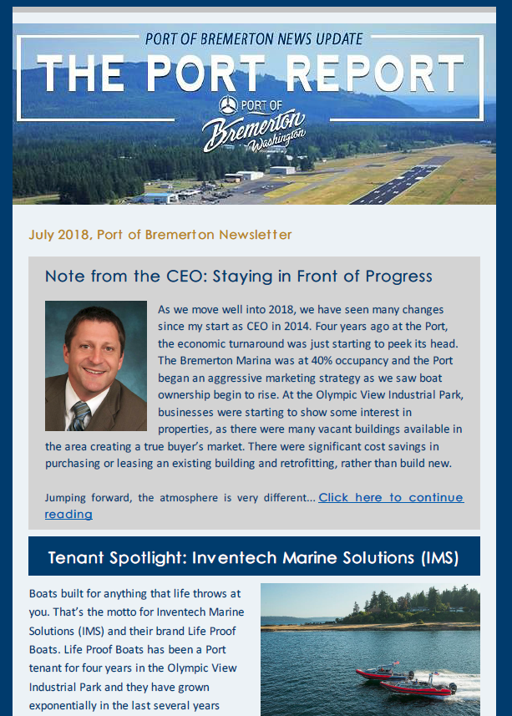
Quarterly Newsletter – The Port Report
Newsletter Process
Meet with executive staff to review recent projects/updates.
Prioritize topics to include information on all our sectors – Industrial/Business, Marine, Airport, Community Events etc.
2018 began quarterly newsletter.
Full news stories featured on Port website – www.portofbremerton.org

Slide 4
Community Reach
County-wide businesses & local leadership
Elected Officials
Community Members that have elected to receive notification
Visit: www.portofbremerton.org/newsletter to sign up online

Slide 5
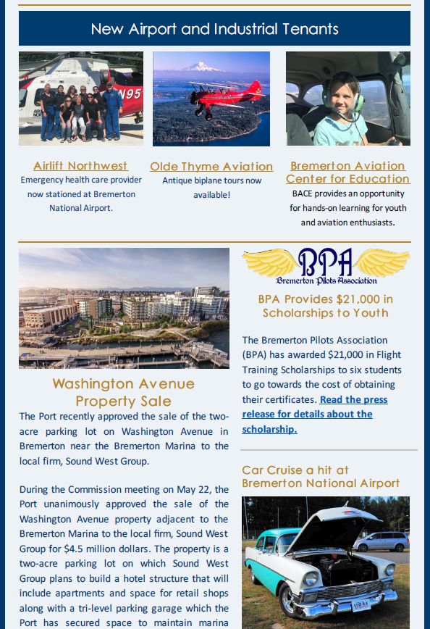
Quarterly Newsletter – The Port Report
July Newsletter Topics
CEO Note
Tenant Spotlight - Inventech
New Airport & Industrial Tenants
Airlift Northwest
Olde Thyme Aviation
BACE
WA Ave Property Sale
BPA Scholarship
Car Cruise – Airport
Wings of Freedom Tour Recap
Upcoming Events
Rock the Docks
POB Comm. Meeting
Fly-In

Slide 6
42% open rate
30% click rate
Sent to over 2K
People who clicked on the email in their inbox
People who clicked on a link in the article
Various distribution lists to send more targeted messages

Slide 7
AUDIENCE
59.6 % Viewed the Newsletter on their Desktop
40.4% Viewed the Newsletter on their Mobile Device

Slide 8
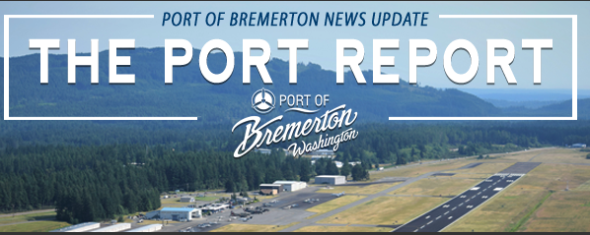
Quarterly Newsletter – The Port Report
October Newsletter Topics
Commissioner Message
Industrial Park Update
New Port Employees
Fly-In Recap
American Cruise Line visit
Tenant Showcase
Upcoming Events

Slide 9
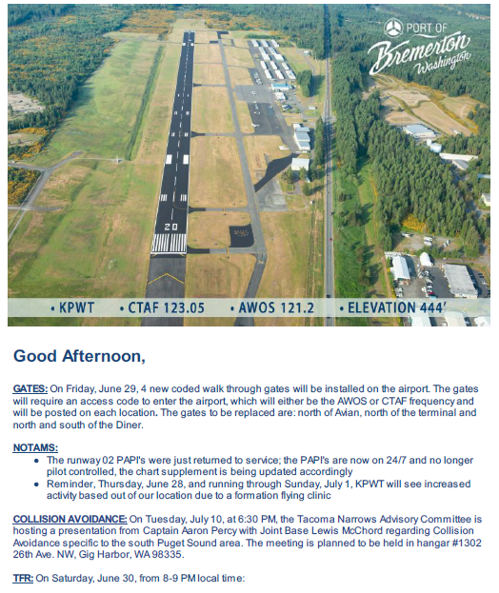
Airport Tenant Updates – PWT Happenings
Airport Tenants Updates
Weather/AWOS
Construction
Events
56% open rate
16% click-through rate

Slide 10
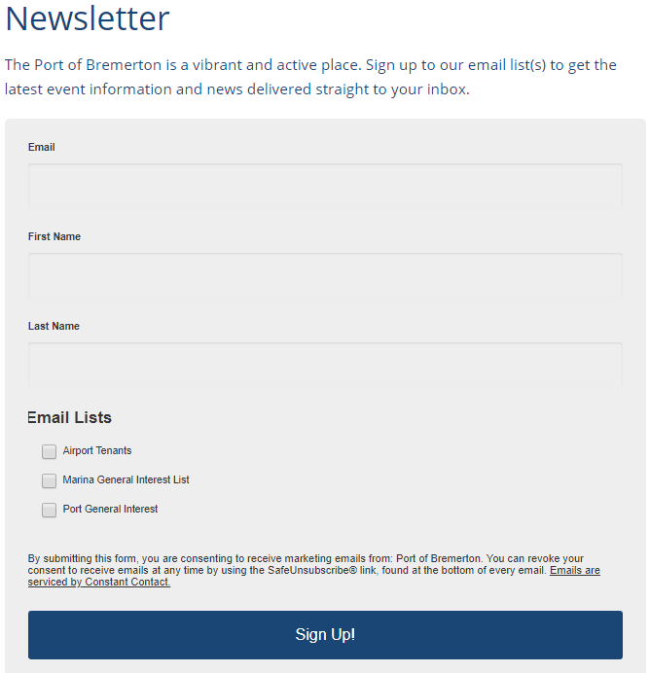
Newsletter Options
Sign up at Tradeshows
Choose Topics of Interest
Tenant News

Slide 11
Newsletter Goals
Learn from our community – what they are interested/want to know more about to continue to provide relevant content to the public.
Continue timely, consistent messaging via e-blasts, newsletters and social media content
Maintain updated contact lists - engage more community members in what we do and who we are.

Slide 12
Thank you!

